Slide 1
SAS BASE 1~6장

Slide 2
목차
기초개념
파일의 참조와 옵션 설정
SAS 프로그램 편집과 디버깅
보고서 작성
Raw data로 부터 SAS 데이터 생성
DATA 단계의 이해

Slide 3
1장. 기초개념
SAS 프로그램의 단계와 구문
라이브러리의 개념
SAS data set

Slide 4
SAS 프로그래밍
data clinic.admit2;
set clinic.admit;
run;
proc print data=clinic.admit2;
run;
Statement, Step이란?

Slide 5
step
DATA 단계와 PROC단계로 구성
DATA step의 경우 분할, 병합, 수정 및 값 계산 등을 통해 새로운 SAS데이터를 만드는 단계
PROC step의 경우 사전에 정의된 코드를 실행하여 분석결과나 보고서 산출하는 단계

Slide 6
SAS Statment
세미콜론 ( ; )을 이용하여 문장 종료
data clinic.admit2;
set clinic.admit; run;
proc print data=clinic.admit2;
run;

Slide 7
SAS프로그램의 처리과정
DATA, PROC, RUN, QUIT 문장을 발견하면 프로그램을 읽는 것을 중단하고 이전 단계를 실행
data clinic.admit2;
set clinic.admit;
run;
proc print data=clinic.admit2;
run;

Slide 8
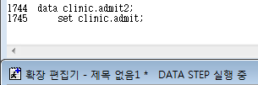

SAS프로그램의 처리과정
각 단계가 실행될 때마다 로그 출력
SAS 로그는 프로그램의 처리와 오류에 대한 기록

Slide 9
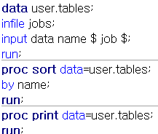
2. How many program steps are executed when the program below is processed?
Three
Four
Five
Six

Slide 10
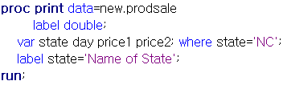
9. How many statements does the following SAS program contain?
Three b. Four c. Five d. six

Slide 11
라이브러리
SAS파일들의 저장소 역할
임시적(Temporary), 영구적(Permanent) 저장
파일 참조
두 단위 이름 참조
임시적 참조(한 단위 이름 참조)
영구적 참조(두 단위 이름 참조)
WORK.Filename
Filename
LIBREF.Filename

Slide 12
6. Which of the following file is a permanent SAS file?
A. Sashelp.Prdsale
B. Sasuser.Mysales
C. Profits.Quarter1
D. all of the above

Slide 13
7. In a DATA step, how can you reference a temporary SAS data set named Forecast?
A. Forecast
B. Work.Forecast
C. Sales.Forecast(after assigning the libref Sales)
D. only a and b above

Slide 14

Data set 명명 규칙
최소 1개의 문자에서 최대 32개 문자 할당 가능
첫 이름은 문자 또는 언더스코어(_)로만 시작가능
두번째 이후의 이름은 숫자,문자, 언더스코어의 조합으로 구성 가능
유효한 데이터 셋 이름
Payroll, _data, a123 등
유효하지 않은 데이터 셋 이름
1data, 32개 이상의 문자할당 시 오류 발생

Slide 15
5. Which of the following variable names is valid?
A. 4BirthDate
B. $Cost
C. _Items_
D. Tax-Rate

Slide 16
10. What is a SAS data library?
A. a collection of SAS files, such as SAS data sets and catalogs
B. in some operating environments ,a physical collection of SAS files
C. in some operationg environments, a logically related collection of SAS files
D. all of the above

Slide 17
SAS data set
서술자(descriptor) 부분과 데이터부분으로 구성
서술자 부분
데이터 세트의 이름
생성된 날짜 및 시간
관측치의 수
변수의 총 개수
Proc contents 문을 이용해 확인 가능
데이터 부분

Slide 18
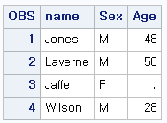
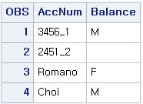
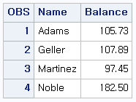
데이터부분

Slide 19
변수의 속성
이름(생략)
유형
문자형, 숫자형으로 구분
길이
문자형의 경우 32,767자리
숫자형 변수들의 경우 기본적으로 8이 할당

Slide 20
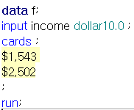
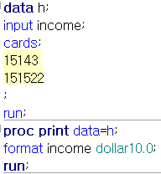
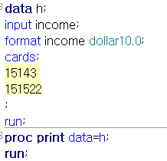


Format /informat
특정한 형식으로 값을 출력 문자형, 숫자형, 날짜형 포맷 을 제공하며 사용자 정의 포맷 생성 가능 | 특정 형식으로 외부파일을 SAS에 읽어 오는 것

Slide 21


레이블
최대 256개의 문자를 가진 레이블을 할당 가능

Slide 22
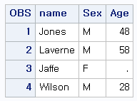
1. How many observations and variables does the data set below contain?
A. 3 observations, 4 variables
B. 3 observations, 3 variables
C. 4 observations, 3 variables
D. can’t tell because some values are missing

Slide 23
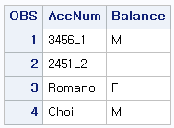
3. What type of variable is the variable AccNum in the data set below?
A. numeric
B. character
C. can be either character or numeric
D. can’t tell from the data shown

Slide 24
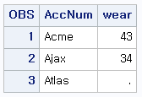
4. What type of variable is the variable is the variable Wear in the data set below?
A. numeric
B. character
C. can be either character or numeric
D. can’t tell from the data shown

Slide 25
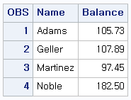
8. What is the default length for the numeric variable Balance?
A. 5
B. 6
C. 7
D. 8

Slide 26
2장. 파일의 참조와 옵션 설정
라이브러리
SAS 시스템 옵션 설정
연도값 다루기
관측치 지정

Slide 27
SAS 라이브러리
기본 라이브러리
Sashelp : 읽기만 가능
Sasuser
Work : 임시 라이브러리
Libname libref ‘SAS-data-library’;
라이브러리명은 최대 8자의 문자(넘으면 오류)
문자나 밑줄로 시작하며 문자 숫자 밑줄을 포함할 수 있다.

Slide 28
다른형식파일과 라이브러리
SAS 파일의 형태가 아닌 경우 이 파일을 SAS에서 사용할 수 있게 엔진을 이용해 파일을 읽거나 쓸 수 있다.

Slide 29


라이브러리의 내용보기
_ALL_를 지정하였을 때만 nods를 지정할 수 있다.

Slide 30
3.When you specify an engine for a library, you are always specifying
A. the file format for files that are stored in the library.
B. the version of SAS that you are using.
C. access to other soft ware vendors files.
D. instructions for creating temporary SAS files.
라이브러리에 대한 엔진을 지정할 때 항상 라이브러리에 저장된 파일의 형식을 지정합니다.

Slide 31
4. Which statement prints a summary of all the files stored in the library named Area 51?
A. proc contents data=area51._all_nods;
B. proc contents data=area51 _all_nods;
C. proc contents data=area51 _all_noobs;
D. proc contents data=area51 _all_ .nods;

Slide 32
6. Which of the following programs correctly references a SAS data set names SalesAnalysis that is stored in a permanent SAS library?
A. data saleslibrary.salesanalysis;
Set mydata.quarterlsales;
If sales>1000000;
Run;
B. Data mysales.totals;
Set sales_99.salesanalysis;
If totalsales>50000;
run;

Slide 33
6. Which of the following programs correctly references a SAS data set names SalesAnalysis that is stored in a permanent SAS library?
C. proc print data=salesanalysis.quarter1;
Var sales salesrep month;
run;
D. proc freq data=1999data.salesanalysis;
Table quarter*sales;
run;

Slide 34
Assuming you are using SAS code and not special SAS windows, which one of the following statements is false?
a. LIBNAME statements can be stored with a SAS program to reference the SAS library automatically when you submit the program.
b. When you delete a libref, SAS no longer has access to the files in the library. However, the contents of the library still exist on your operating system.
c. Librefs can last from one SAS session to another.
d. You can access files that were created with other vendors' software by submitting a LIBNAME statement.

Slide 35
9. What does the following statement do?
Libname osiris spss ‘c:\myfiles\sasdata\data’;
A. defines a library called Spss using the OSIRIS engine.
B. defines a library called Osiris using the SPSS engine
C. defines two libraries called Osiris and Spss using the default engine.
D. defines the default library using the OSIRIS and SPSS engines.

Slide 36
SAS 시스템 옵션 설정
어디서나 실행 가능
실행하면 SAS 끄기 전까지 계속 적용
NUMBER | NONUMBER
DATE|NODATE
PAGENO : 출력물의 시작페이지 설정
PAGESIZE : 출력물의 행수 설정(row 설정)
LINESIZE : 출력물의 폭을 지정

Slide 37
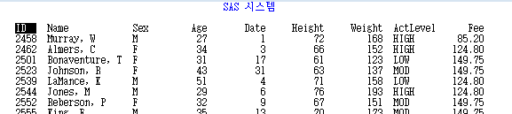
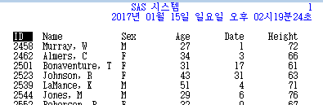

Slide 38
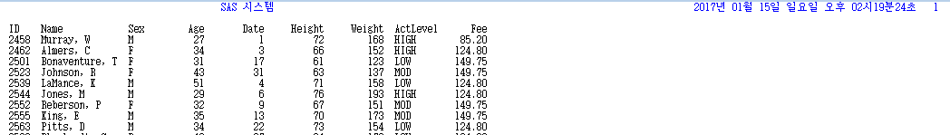
5. The following PROC PRINT output was created immediately after PROC TABULATE output. Which SAS system options were specified when the report was created?
A. OBS=, DATE, and NONUMBER
B. PAGENO=1 and DATE.
C. NUMBER and DATE only
D. none if the above

Slide 39
10. what does the following OPTIONS statement do?
options pagesize=15 nodate;
A. suppresses the date and limits the page size of the log.
B. suppresses the date and limits the vertical page size for text output
C. suppresses the date and limits the vertical page size for text and HTML output
D. suppresses the date and limits the horizontal page size for text output

Slide 40
1. If you submit the following program, how does the output look?
options pagesize=55 nonumber; proc tabulate data=clinic.admit;
class actlevel;
var age height weight;
table actlevel,(age height weight)*mean; run;
options linesize=80;
proc means data=clinic.heart min max maxdec=1;
var arterial heart cardiac urinary;
class survive sex; run;
a. The PROC MEANS output has a print line width of 80 characters, but the PROC TABULATE output has no print line width.
b. The PROC TABULATE output has no page numbers, but the PROC MEANS output has page numbers.

Slide 41
1. If you submit the following program, how does the output look?
options pagesize=55 nonumber; proc tabulate data=clinic.admit;
class actlevel;
var age height weight;
table actlevel,(age height weight)*mean; run;
options linesize=80;
proc means data=clinic.heart min max maxdec=1;
var arterial heart cardiac urinary;
class survive sex; run;
c. Each page of output from both PROC steps is 55 lines long and has no page numbers, and the PROC MEANS output has a print line width of 80 characters.
d. The date does not appear on output from either PROC step.

Slide 42
연도값 다루기
SAS의 경우 두자리 연도값을 읽을 때 지정된 값으로부터 100년을 연도로 해석
기본값은 1920년(1920~2019)
Options yearcutoff=1920;
4자리수의 경우 yearcutoff 영향 X
날짜 | SAS 기준
12/07/41 | 12/07/1941
18Dec15 | 18Dec2015
04/15/30 | 04/15/1930
15Apr95 | 15Apr1995

Slide 43
2. In order for the date values 05May1995 and 04Mar 2046 to be read correctly, what value must the YEARCUTOFF=option have?
A. a value between 1947 and 1994, inclusive
B. 1995 or higher
C. 1946 or higher
D. any value

Slide 44
7. Which time span is used to interpret two-digit year values if the YEARCUTOFF= option is set to 1950?
A. 1950~2049
B. 1950~2050
C. 1949~2050
D. 1950~2000

Slide 45

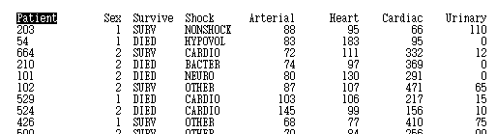
관측치 지정
Firstobs=n 옵션은
처음시작 할 관측치 위치 지정
Obs=n 옵션은 마지막 관측치 위치 지정
총 6개

Slide 46
SAS프로그램 편집과 디버깅
구문오류
데이터오류

Slide 47
구문오류
세미콜론 누락
따옴표 불균형
유효하지 않은 옵션

Slide 48
1. As you write and edit SAS programs it's a good idea to
a. begin DATA and PROC steps in column one.
b. indent statements within a step.
c. begin RUN statements in column one.
d. do all of the above.

Slide 49
2. What usually happens when a syntax error is detected?
a. SAS continues processing the step.
b. SAS continues to process the step, and the Log displays messages about the error.
c. SAS stops processing the step in which the error occurred, and the Log displays messages about the error.
d. SAS stops processing the step in which the error occurred, and the Output window displays messages about the error

Slide 50
3. A syntax error occurs when
a. some data values are not appropriate for the SAS statements that are specified in a program.
b. the form of the elements in a SAS statement is correct, but the elements are not valid for that usage.
c. program statements do not conform to the rules of the SAS language.
d. none of the above

Slide 51
4. How can you tell whether you have specified an invalid option in a SAS program?
a. A log message indicates an error in a statement that seems to be valid.
b. A log message indicates that an option is not valid or not recognized.
c. The message "PROC running" or "DATA step running" appears at the top of the active window.
d. You can't tell until you view the output from the program.

Slide 52
5. Which of the following programs contains a syntax error?
a. proc sort data=sasuser.mysales; by region; run;
b. dat sasuser.mysales; set mydata.sales99; run;
c. proc print data=sasuser.mysales label; label region='Sales Region'; run;
d. none of the above

Slide 53
보고서 생성
Proc print
정렬
합계 및 소계
제목 및 각주 미주
포맷

Slide 54
Proc print 옵션
Where 출력되는 관측치에 조건문 적용
Var 변수 선택
Noobs (29page nods 와 헛깔리지말기)
Double 행과 행사이 띄어쓰기
(HTML에 적용되지 않음)

Slide 55
1. Which PROC PRINT step below creates the following output?
a. proc print data=flights.laguardia noobs;
var on changed flight; where on>=160; run;
b. proc print data=flights.laguardia;
var date on changed flight; where changed>3; run;
Date | On | Changed | Flight
04MAR99 | 232 | 18 | 219
05MAR99 | 160 | 4 | 219
06MAR99 | 163 | 14 | 219
07MAR99 | 241 | 9 | 219
08MAR99 | 183 | 11 | 219
09MAR99 | 211 | 18 | 219
10MAR99 | 167 | 7 | 219

Slide 56
1. Which PROC PRINT step below creates the following output?
c. proc print data=flights.laguardia label; id date;
var boarded transferred flight;
label boarded='On' transferred='Changed';
where flight='219'; run;
d. proc print flights.laguardia noobs; id date;
var date on changed flight;
where flight='219'; run;
Date | On | Changed | Flight
04MAR99 | 232 | 18 | 219
05MAR99 | 160 | 4 | 219
06MAR99 | 163 | 14 | 219
07MAR99 | 241 | 9 | 219
08MAR99 | 183 | 11 | 219
09MAR99 | 211 | 18 | 219
10MAR99 | 167 | 7 | 219

Slide 57
5. Which options are used to create the following PROC PRINT output?
a. the DATE system option and the LABEL option in PROC PRINT
b. the DATE and NONUMBER system options and the DOUBLE and NOOBS options in PROC PRINT
c. the DATE and NONUMBER system options and the DOUBLE option in PROC PRINT
d. the DATE and NONUMBER system options and the NOOBS option in PROC PRINT
13:27 Monday, March 22, 1999
Patient | Arterial | Heart | Cardiac | Urinary
203 | 88 | 95 | 66 | 110
54 | 83 | 183 | 95 | 0
664 | 72 | 111 | 332 | 12
210 | 74 | 97 | 369 | 0
101 | 80 | 130 | 291 | 0

Slide 58
10. What does PROC PRINT display by default?
a. PROC PRINT does not create a default report; you must specify the rows and columns to be displayed.
b. PROC PRINT displays all observations and variables in the data set. If you want an additional column for observation numbers, you can request it.
c. PROC PRINT displays columns in the following order: a column for observation numbers, all character variables, and all numeric variables.
d. PROC PRINT displays all observations and variables in the data set, a column for observation numbers on the far left, and variables in the order in which they occur in the data set.

Slide 59
연산자
기호 | 의미
= or eq | 같음
^= or ne | 같지 않다
> or gt | 크다
< or lt | 작다
>= or ge | 크거나 같다
<= or le | 작거나 같다
Contains or ? | 문자열을 포함한다.
And & | 그리고
Or | | 또는
In (값1, 값2, 값3) | 값1,2,3 중 하나를 포함

Slide 60
3. Which of the following statements selects from a data set only those observations for which the value of the variable Style is RANCH, SPLIT, or TWOSTORY?
a. where style='RANCH' or 'SPLIT' or 'TWOSTORY';
b. where style in 'RANCH' or 'SPLIT' or 'TWOSTORY';
c. where style in (RANCH, SPLIT, TWOSTORY);
d. where style in ('RANCH','SPLIT','TWOSTORY');

Slide 61
9. Choose the statement below that selects rows in which
the amount is less than or equal to $5000
the account is 101-1092 or the rate equals 0.095.
a. where amount <= 5000 and account='101-1092' or rate = 0.095;
b. where (amount le 5000 and account='101-1092') or rate = 0.095;
c. where amount <= 5000 and (account='101-1092' or rate eq 0.095);
d. where amount <= 5000 or account='101-1092' and rate = 0.095;

Slide 62
정렬
Proc sort data=clinic.admit out=admit;
By 변수1 descending 변수2 ;
Run;
Descending 내림차순 유무
오름차순 : 위로 갈수록 작은 값

Slide 63
4. If you want to sort your data and create a temporary data set named Calc to store the sorted data, which of the following steps should you submit?
a. proc sort data=work.calc out=finance.dividend; run;
b. proc sort dividend out=calc; by account; run;
c. proc sort data=finance.dividend out=work.calc;
by account; run;
d. proc sort from finance.dividend to calc;
by account; run;

Slide 64
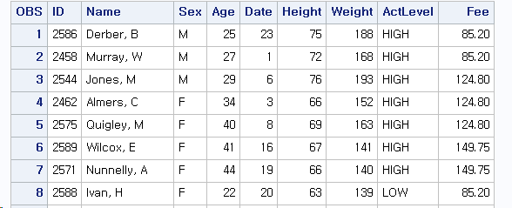
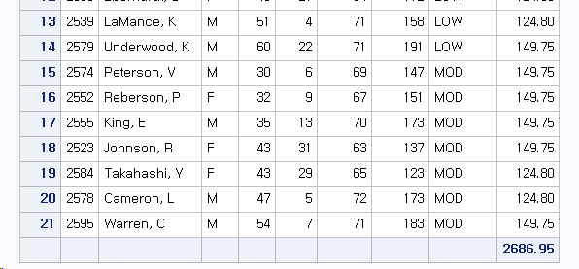
열의 총합
proc print
data=clinic.admit;
Sum fee;
Run;

Slide 65
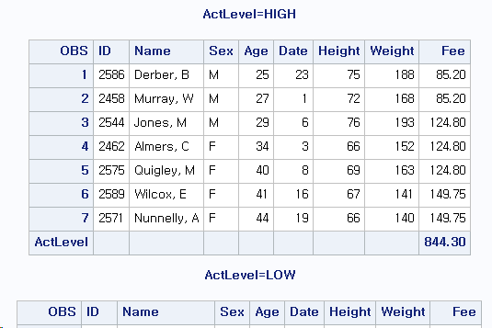
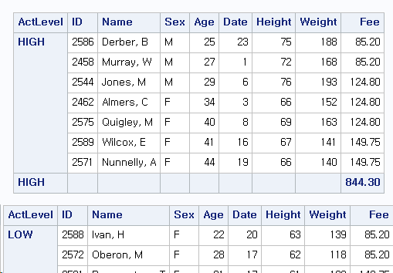
proc sort
data=clinic.admit out=admit;
by actlevel;
run;
proc print data=admit;
Sum fee;
By actlevel;
Run;
proc print data=admit;
Sum fee;
By actlevel;
Id actlevel;
Run;

Slide 66
제목과 각주
Title, footnote 문장은 각각 10개까지 사용가능
전역적
Title1 title3 처럼 한 행을 건너 뛴 경우 title2에 해당하는 행은 공백
Title3가 적용 되있는 상태에서 title1을 적용하는 경우 title3는 사라지고 title1만 적용

Slide 67
LABEL
Proc print data=data label;
label 변수1=‘label1’ 변수2=‘label2’; run;
최대 256문자까지 사용가능

Slide 68
2. Which of the following PROC PRINT steps is correct if labels are not stored with the data set?
a. proc print data=allsales.totals label; label region8='Region 8 Yearly Totals'; run;
b. proc print data=allsales.totals; label region8='Region 8 Yearly Totals'; run;
c. proc print data allsales.totals label noobs; run;
d. proc print allsales.totals label; run;

Slide 69
포맷
Format 변수 dollar4.;
Ex)
MMDDYY8. → 06/05/03
Comma5.0 → 1,234
W.d → 8.2
DATEw. → 16OCT1999(DATE9.)

Slide 70
6. Which of the following statements can you use in a PROC PRINT step to create this output?
a. var month instructors; sum instructors aerclass walkjogrun swim;
b. var month; sum instructors aerclass walkjogrun swim;
c. var month instructors aerclass; sum instructors aerclass walkjogrun swim;
d. all of the above
Month | Instructors | AerClass | WalkJogRun | Swim
01 | 1 | 37 | 91 | 83
02 | 2 | 41 | 102 | 27
03 | 1 | 52 | 98 | 19
04 | 1 | 61 | 118 | 22
05 | 3 | 49 | 88 | 29
 | 8 | 240 | 497 | 180

Slide 71
7. What happens if you submit the following program?
proc sort data=clinic.diabetes;
run;
proc print data=clinic.diabetes;
var age height weight pulse;
where sex='F'; run;
a. The PROC PRINT step runs successfully, printing observations in their sorted order.
b. The PROC SORT step permanently sorts the input data set.
c. The PROC SORT step generates errors and stops processing, but the PROC PRINT step runs successfully, printing observations in their original (unsorted) order.
d. The PROC SORT step runs successfully, but the PROC PRINT step generates errors and stops processing.

Slide 72
8. If you submit the following program, which output does it create?
proc sort data=finance.loans out=work.loans;
by months amount; run;
proc print data=work.loans noobs;
var months; sum amount payment; where months<360; run;
Months | Amount | Payment
12 | $3,500 | $308.52
24 | $8,700 | $403.47
36 | $10,000 | $325.02
48 | $5,000 | $128.02
 | $27,200 | $1,165.03
Months | Amount | Payment
12 | $3,500 | $308.52
24 | $8,700 | $403.47
36 | $10,000 | $325.02
48 | $5,000 | $128.02
 | 27,200 | 1,165.03

Slide 73
8. If you submit the following program, which output does it create?
proc sort data=finance.loans out=work.loans;
by months amount; run;
proc print data=work.loans noobs;
var months; sum amount payment; where months<360; run;
Months | Amount | Payment
12 | $3,500 | $308.52
48 | $5,000 | $128.02
24 | $8,700 | $403.47
36 | $10,000 | $325.02
 | $27,200 | $1,165.03
Months | Amount | Payment
12 | $3,500 | $308.52
24 | $8,700 | $403.47
36 | $10,000 | $325.02
48 | $5,000 | $128.02
 |  | $1,165.03

Slide 74
원시데이터로부터 SAS데이터 생성
생성 과정
열입력

Slide 75
외부 데이터로 sas데이터 생성
작업명 | SAS statement
SAS 라이브러리 참조 | Libname
외부파일 참조 | Filename
SAS 데이터셋 명명 | Data
외부파일 인식 | Infile
data 기술 | Input
Data step 실행 | Run
data 나열 | Proc print
프로시져 실행 | Run

Slide 76
열입력
File name exer ‘c\user\exer.dat’;
Data exercise;
Infile exer;
Input id $ 1-4 age 6-7 actlevel $ 9-12 sex $14; run;

Slide 77
1. Which SAS statement associates the fileref Crime with the raw data file C:\States\Data\Crime?
a. filename crime 'c:\states\data\crime';
b. filename crime c:\states\data\crime;
c. fileref crime 'c:\states\data\crime';
d. filename 'c:\states\data\crime' crime;

Slide 78
2. Filerefs remain in effect until .
a. you change them.
b. you cancel them.
c. you end your SAS session.
d. all of the above

Slide 79
3. Which statement identifies the name of a raw data file to be read with the fileref Products and specifies that the DATA step read only records 1-15?
a. infile products obs 15;
b. infile products obs=15;
c. input products obs=15;
d. input products 1-15;

Slide 80
4. Which of the following programs correctly writes the observations from the data set below to a raw data file?
a. data _null_; set work.patients; infile 'c:\clinic\patients\referals.dat'; input id 1-4 sex 6 age 8-9 height 11-12 weight 14-16 pulse 18-20; run;
b. data referals.dat; set work.patients; input id 1-4 sex 6 age 8-9 height 11-12 weight 14-16 pulse 18-20; run;
ID | Sex | Age | Height | Weight | Pulse
2304 | F | 16 | 61 | 102 | 100
1128 | M | 43 | 71 | 218 | 76
4425 | F | 48 | 66 | 162 | 80
1387 | F | 57 | 64 | 142 | 70
9012 | F | 39 | 63 | 157 | 68
6312 | M | 52 | 72 | 240 | 77
5438 | F | 42 | 62 | 168 | 83
3788 | M | 38 | 73 | 234 | 71
9125 | F | 56 | 64 | 159 | 70
3438 | M | 15 | 66 | 140 | 67

Slide 81
4. Which of the following programs correctly writes the observations from the data set below to a raw data file?
c. data _null_; set work.patients; file c:\clinic\patients\referals.dat; put id 1-4 sex 6 age 8-9 height 11-12 weight 14-16 pulse 18-20; run;
d. data _null_; set work.patients; file 'c:\clinic\patients\referals.dat'; put id 1-4 sex 6 age 8-9 height 11-12 weight 14-16 pulse 18-20; run;
ID | Sex | Age | Height | Weight | Pulse
2304 | F | 16 | 61 | 102 | 100
1128 | M | 43 | 71 | 218 | 76
4425 | F | 48 | 66 | 162 | 80
1387 | F | 57 | 64 | 142 | 70
9012 | F | 39 | 63 | 157 | 68
6312 | M | 52 | 72 | 240 | 77
5438 | F | 42 | 62 | 168 | 83
3788 | M | 38 | 73 | 234 | 71
9125 | F | 56 | 64 | 159 | 70
3438 | M | 15 | 66 | 140 | 67

Slide 82
5. Which raw data file can be read using column input?
1---+----10---+----20---+
Henderson CA 26 ADM
Josephs SC 33 SALES
Williams MN 40 HRD
Rogan NY RECRTN
1---+----10---+----20---+----30
2803 Deborah Campos 173.97
2912 Bill Marin 205.14
3015 Helen Stinson 194.08
3122 Nicole Terry 187.65
1---+----10---+----20---+
Avery John $601.23
Davison Sherrill $723.15
Holbrook Grace $489.76
Jansen Mike $638.42

Slide 83
6. Which program creates the output shown below?
a. data work.salesrep; infile empdata; input ID $ 1-4 LastName $ 6-12 FirstName $ 14-18 City $ 20-29; run; proc print data=work.salesrep; run;
b. data work.salesrep; infile empdata; input ID $ 1-4 Name $ 6-12 FirstName $ 14-18 City $ 20-29; run; proc print data=work.salesrep; run;
1---+----10---+----20---+----30
3427 Chen Steve Raleigh
1436 Davis Lee Atlanta
2812 King Vicky Memphis
1653 Sanchez Jack Atlanta
Obs | ID | LastName | FirstName | City
1 | 3427 | Chen | Steve | Raleigh
2 | 1436 | Davis | Lee | Atlanta
3 | 2812 | King | Vicky | Memphis
4 | 1653 | Sanchez | Jack | Atlanta

Slide 84
6. Which program creates the output shown below?
c. data work.salesrep; infile empdata; input ID $ 1-4 name1 $ 6-12 name2 $ 14-18 City $ 20-29; run; proc print data=work.salesrep; run;
d. all of the above
1---+----10---+----20---+----30
3427 Chen Steve Raleigh
1436 Davis Lee Atlanta
2812 King Vicky Memphis
1653 Sanchez Jack Atlanta
Obs | ID | LastName | FirstName | City
1 | 3427 | Chen | Steve | Raleigh
2 | 1436 | Davis | Lee | Atlanta
3 | 2812 | King | Vicky | Memphis
4 | 1653 | Sanchez | Jack | Atlanta

Slide 85
7. Which statement correctly reads the fields in the following order: StockNumber, Price, Item, Finish, Style?
Field Name Start Column End Column Data Type
StockNumber 1 3 character
Finish 5 9 character
Style 11 18 character
Item 20 24 character
Price 27 32 numeric
a. input StockNumber $ 1-3 Finish $ 5-9 Style $ 11-18 Item $ 20-24 Price 27-32;
b. input StockNumber $ 1-3 Price 27-32 Item $ 20-24 Finish $ 5-9 Style $ 11-18;
c. input $ StockNumber 1-3 Price 27-32 $ Item 20-24 $ Finish 5-9 $ Style 11-18;
d. input StockNumber $ 1-3 Price $ 27-32 Item $ 20-24 Finish $ 5-9 Style $ 11-18;
1---+----10---+----20---+----30---+
310 oak pedestal table 329.99
311 maple pedestal table 369.99
312 brass floor lamp 79.99
313 glass table lamp 59.99
313 oak rocking chair 153.99

Slide 86
8. Which statement correctly re-defines the values of the variable Income as 100 percent higher?
a. income=income*1.00;
b. income=income+(income*2.00);
c. income=income*2;
d. income=*2;

Slide 87
9. Which program correctly reads instream data?
a.
data finance.newloan;
input datalines;
if country='JAPAN';
MonthAvg=amount/12;
1998 US CARS 194324.12
1998 US TRUCKS 142290.30
1998 CANADA CARS 10483.44
1998 CANADA TRUCKS 93543.64
1998 MEXICO CARS 22500.57
1998 MEXICO TRUCKS 10098.88
1998 JAPAN CARS 15066.43
1998 JAPAN TRUCKS 40700.34 ;
b. data finance.newloan;
input Year 1-4 Country $ 6-11
Vehicle $ 13-18 Amount 20-28;
if country='JAPAN';
MonthAvg=amount/12;
datalines; run;

Slide 88
9. Which program correctly reads instream data?
c. data finance.newloan;
input Year 1-4 Country 6-11
Vehicle 13-18 Amount 20-28;
if country='JAPAN';
MonthAvg=amount/12;
datalines;
1998 US CARS 194324.12
1998 US TRUCKS 142290.30
1998 CANADA CARS 10483.44
1998 CANADA TRUCKS 93543.64
1998 MEXICO CARS 22500.57
1998 MEXICO TRUCKS 10098.88
1998 JAPAN CARS 15066.43
1998 JAPAN TRUCKS 40700.34 ;
d.
data finance.newloan;
input Year 1-4 Country $ 6-11
Vehicle $ 13-18 Amount 20-28;
if country='JAPAN'; MonthAvg=amount/12;
datalines;
1998 US CARS 194324.12
1998 US TRUCKS 142290.30
1998 CANADA CARS 10483.44
1998 CANADA TRUCKS 93543.64
1998 MEXICO CARS 22500.57
1998 MEXICO TRUCKS 10098.88
1998 JAPAN CARS 15066.43
1998 JAPAN TRUCKS 40700.34 ;

Slide 89
10. Which SAS statement subsets the raw data shown below so that only the observations in which Sex (in the second field) has a value of F are processed?
a. if sex=f;
b. if sex=F;
c. if sex='F';
d. a or b
----+----10---+----20---+-
Alfred M 14 69.0 112.5
Becka F 13 65.3 98.0
Gail F 14 64.3 90.0
Jeffrey M 13 62.5 84.0
John M 12 59.0 99.5
Karen F 12 56.3 77.0
Mary F 15 66.5 112.0
Philip M 16 72.0 150.0
Sandy F 11 51.3 50.5
Tammy F 14 62.8 102.5
William M 15 66.5 112.0

Slide 90
DATA 단계의 이해
컴파일 단계
실행 단계
구문오류
자동변수

Slide 91
컴파일 단계
Data perm.updata;
Infile invent;
Input Item $ 1-13 Idnum $ 15-19
Instock 21-22 Backord 24-25;
Total=instock+backord;
Run;
입력 버퍼
프로그렘 데이터 벡터

Slide 92
구문오류
빠져있거나 잘못된 키워드
타당하지 않은 변수명
빠져 있거나 타당하지 않은 구두점
타당하지 않은 옵션
컴파일 단계의 오류는 정지하나 실행단계의 오류는 case by case

Slide 93
1. Which of the following is not created during the compilation phase?
a. the data set descriptor
b. the first observation
c. the program data vector
d. the _N_ and _ERROR_ automatic variables

Slide 94
2. During the compilation phase, SAS scans each statement in the DATA step, looking for syntax errors. Which of the following is not considered a syntax error?
a. incorrect values and formats
b. invalid options or variable names
c. missing or invalid punctuation
d. missing or misspelled keywords

Slide 95
3. Unless otherwise directed, the DATA step executes.
a. once for each compilation phase.
b. once for each DATA step statement.
c. once for each record in the input file.
d. once for each variable in the input file.

Slide 96
4. At the beginning of the execution phase, the value of _N_ is 1, the value of _ERROR_ is 0, and the values of the remaining variables are set to
a. 0
b. 1
c. undefined
d. missing

Slide 97
5. Suppose you run a program that causes three DATA step errors. What is the value of the automatic variable _ERROR_ when the observation that contains the third error is processed?
a. 0
b. 1
c. 2
d. 3

Slide 98
6. Which of the following actions occurs at the end of the DATA step?
a. The automatic variables _N_ and _ERROR_ are incremented by one.
b. The DATA step stops execution.
c. The descriptor portion of the data set is written.
d. The values of variables created in programming statements are re-set to missing in the program data vector.

Slide 99
7. Look carefully at the DATA step shown below. Based on the INPUT statement, in what order will the variables be stored in the new data set?
data perm.update;
infile invent;
input IDnum $ 15-19 Item $ 1-13 Instock 21-22 BackOrd 24-25;
Total=instock+backord; run;
a. IDnum Item InStock BackOrd Total
b. Item IDnum InStock BackOrd Total
c. Total IDnum Item InStock BackOrd
d. Total Item IDnum InStock BackOrd

Slide 100
8. If SAS cannot interpret syntax errors, then.
a. data set variables will contain missing values.
b. the DATA step does not compile.
c. the DATA step still compiles, but it does not execute.
d. the DATA step still compiles and executes.

Slide 101
9. What is wrong with this program?
data perm.update;
infile invent input Item $ 1-13 IDnum $ 15-19
Instock 21-22 BackOrd 24-25;
total=instock+backord; run;
a. missing semicolon on second line
b. missing semicolon on third line
c. incorrect order of variables
d. incorrect variable type

Slide 102
10. Look carefully at this section of a SAS session log. Based on the note, what was the most likely problem with the DATA step?
a. A keyword was misspelled in the DATA step.
b. A semicolon was missing from the INFILE statement.
c. A variable was misspelled in the INPUT statement.
d. A dollar sign was missing in the INPUT statement.
NOTE: Invalid data for IDnum in line 7 15-19. RULE: ----+----1----+----2----+----3----+----4 7 Bird Feeder LG088 3 20 Item=Bird Feeder IDnum=. InStock=3 BackOrd=20 Total=23 _ERROR_=1 _N_=1

Slide 103
http://morgan.dartmouth.edu/Docs/60476/m1/m1_34.htm
http://morgan.dartmouth.edu/Docs/60476/m16/m16_33.htm
http://morgan.dartmouth.edu/Docs/60476/m2/m2_44.htm
http://morgan.dartmouth.edu/Docs/60476/m4/m4_54.htm
http://morgan.dartmouth.edu/Docs/60476/m12/m12_47.htm
http://morgan.dartmouth.edu/Docs/60476/m22/m22_46.htm

